Slide 1
UART with AES encryption With performance analysis
Rajan Samar – IMT2023616 Swayam Kotecha – IMT2023615
VLS 505 / System design with FPGA

Slide 2
Problem Statement:
Goal: Use UART to feed data, encrypt the received data with AES and send it to the PC. Implement this in HDL. Compare the implementation with a pipelined version
Objective: Receive data via UART on FPGA, encrypt using AES, and send encrypted data back to PC.
Compare normal AES implementation with a pipelined AES implementation in HDL.

Slide 3
UART
The top module acts as the bridge between the parallel sorter and serial UART.
Protocol:
Baud Rate: 115200.
Clock Frequency: 100 MHz.
CLKS PER BIT: 1000000/1152=868 clock cycles

Slide 4
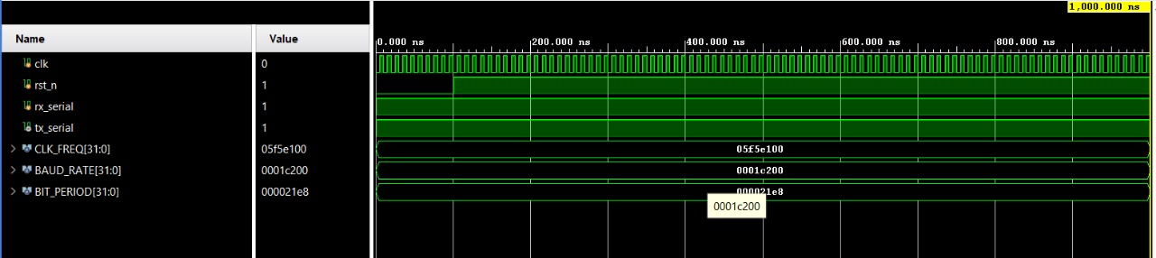
SIMULATION WAVEFORM : ITERATIVE

Slide 5
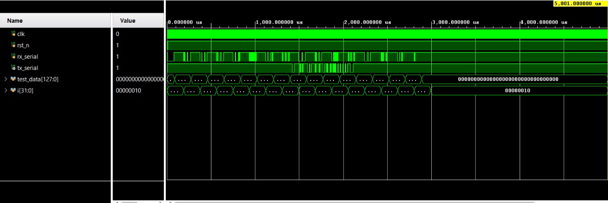
Simulation waveform: PIPELINE

Slide 6
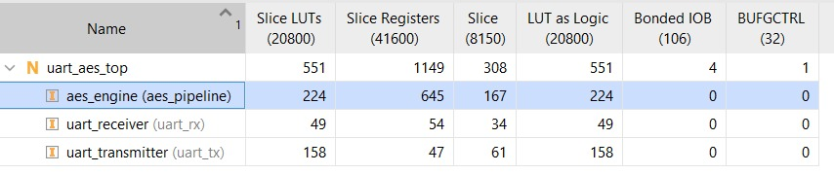
IMPLEMENTATION ANALYSIS: RESOURCE UTILIZATION
Pipelined AES (Full AES Implemented):
Utilization:
551 LUTs, 1149 FFs
(AES engine alone: 224 LUTs, 645 FFs)
Registers are high because each pipeline stage stores intermediate state.
Shorter combinational path → better timing, easier 100 MHz closure.
Ideal for high throughput applications.

Slide 7
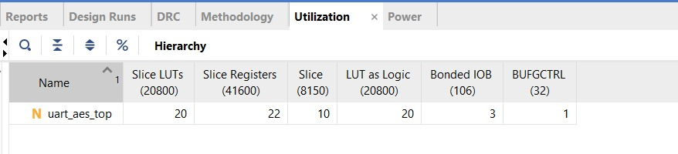
Iterative resource Utilization:
Utilization shown: 20 LUTs, 22 FFs.
Iterative AES normally uses much fewer resources than pipelined AES, but with longer critical path → lower max frequency.

Slide 8
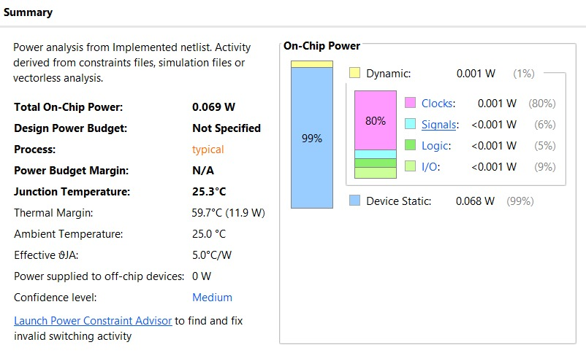
Power Analysis: Iterative
Design | Total On-Chip Power | Dynamic Power | Static Power
Iterative AES | 0.069 W | 0.001 W | 0.068 W
Pipelined AES | 0.075 W | 0.005 W | 0.070 W

Slide 9
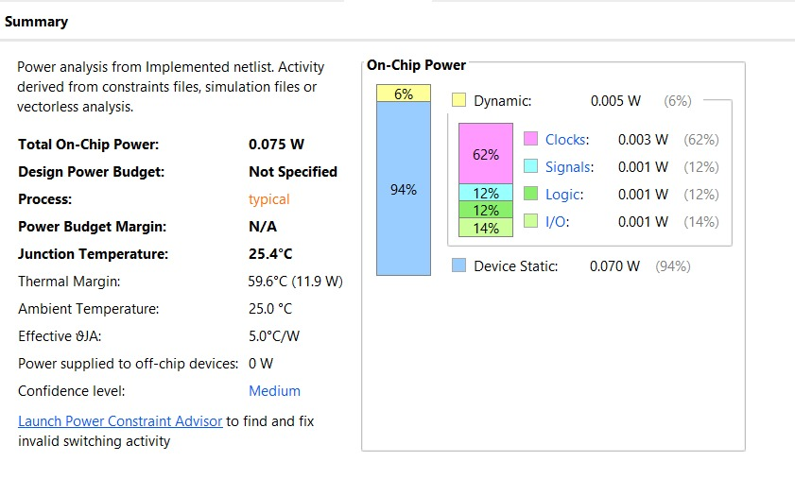
Power analysis: pipelined
Pipelined Version Shows Higher Dynamic Power
Iterative AES Dynamic Power: 0.001 W
Pipelined AES Dynamic Power: 0.005 W
Reason:
Pipeline architecture uses more registers and more switching per clock.
Every stage toggles simultaneously → more signal activity → higher dynamic power.

Slide 10
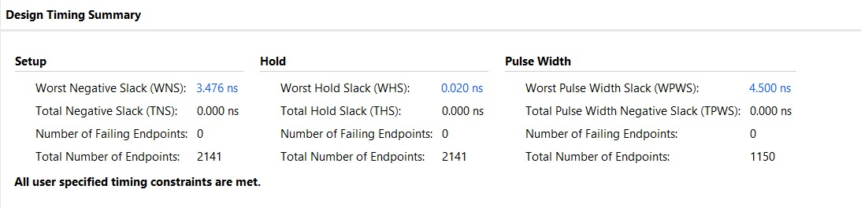
Timing analysis: PIpelined
Pipelined run
WNS_p = +3.476 ns
Path delay = T_constraint − WNS = 10.0 ns − 3.476 ns = 6.524 ns.
Fmax_p = 1 / (path_delay) = 1 / 6.524e-9 s ≈ 153.2 MHz. (report as ~153.2 MHz)
Iterative run
WNS_i = +6.350 ns
Path delay = 10.0 ns − 6.350 ns = 3.65 ns.
Fmax_i = 1 / 3.65e-9 s ≈ 274.0 MHz. (report as ~274.0 MHz)

Slide 11
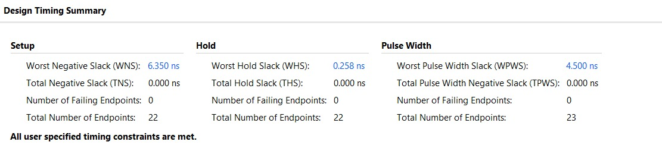
Timing Analysis: iterative
Iterative WNS= 6.350ns
Worst Hold Slack: 0.258ns
Both satisfy hold constraints as greater than 0.

Slide 12
Throughput, area, latency
Pipeline AES (reported)
Area: 551 LUTs, 1149 FFs (AES engine ≈ 224 LUTs / 645 FFs)
Latency: 11 cycles → 110 ns @ 100 MHz; ~71.8 ns @ Fmax (≈153.2 MHz)
Throughput: 1 block/cycle → 100M blocks/s → 12.8 Gbit/s @100 MHz; 153.2M blocks/s → 19.61 Gbit/s @Fmax
Iterative AES (reported)
Area: 20 LUTs, 22 FFs
Latency (assumed 1-round/cycle): 11 cycles → 110 ns @ 100 MHz; ~40.2 ns @ Fmax (≈274.0 MHz)
Throughput (assumed 1-round/cycle): 100 MHz / 11 → 9.09M blocks/s → 1.164 Gbit/s @100 MHz; ~24.91M blocks/s → 3.188 Gbit/s @Fmax

Slide 13
Conclusion:
Throughput: Pipeline is ~11× faster (1 block/cycle).
Latency: Both take 11 cycles, but iterative gives lower ns latency due to higher Fmax.
Area: Pipeline is far larger (≈ 27× LUTs, 52× FFs)
Power: Pipeline consumes slightly more dynamic power

